Slide 1

GeoTox: Integrating Geospatial Exposure Modeling and Adverse Outcome Pathways Towards Mechanistically-Informed Risk
Kyle P Messier, PhD
Stadtman Tenure-Track Investigator
NIEHS, NIMHD

Slide 2


Spatiotemporal Exposures and Toxicology Group
2
Spatiotemporal Exposure Mapping
Chemical and Stressor Mixtures Prediction
Mechanistically Informed Risk Assessment

Slide 3
Outline
3
GeoTox
Computational Best Practices
Background
Exposomics
Adverse Outcome Pathways
Framework
Case Study with Air Pollutant
What the SETgroup is doing thus far
Best Practices for Envr Health

Slide 4
Background
4
Exposomics, Adverse Outcome Pathways, & GeoTox

Slide 5
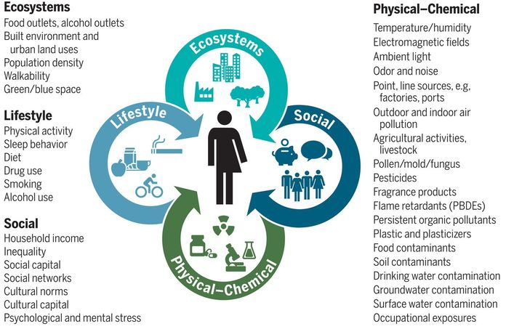

Exposomics
5
The exposome and health: Where chemistry meets biology, Volume: 367, Issue: 6476, Pages: 392-396, DOI: (10.1126/science.aay3164)

Slide 6
Adverse Outcome Pathway
6
Macro-Molecular Interactions
Reception/Ligand Interactions
DBA Binding
Cellular Responses
Gene Activation/Silencing
Protein Production
Organ Responses
Altered Physiology
Altered tissue development
Organism Responses
Population Response
Lethality
Disease Prevalence
Protein Oxidation
Altered Signaling
Impaired Development
Structure
Disease phenotype
OECD.org

Slide 7
Adverse Outcome Pathways
7
Molecular Initiating Event
Key Event 1
Key Event n-1
Key Event n
Adverse Outcome
Molecular Initiating Event
Key Event 1
Key Event n-1
Key Event n
Adverse Outcome
Molecular Initiating Event
Molecular Initiating Event
Key Event 1

Slide 8
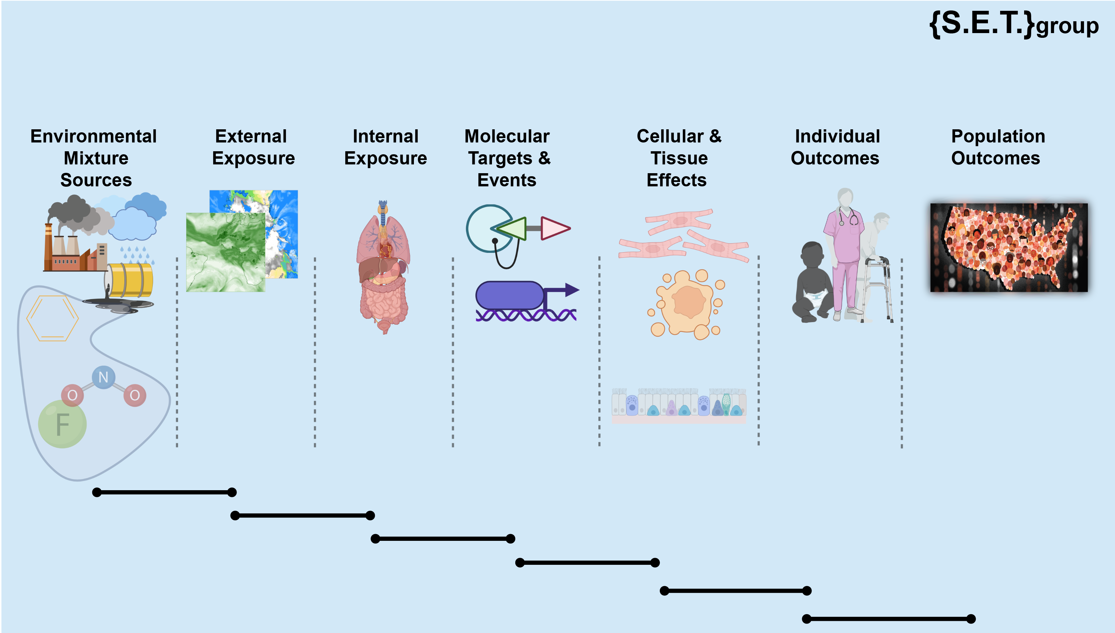
8
A Cascade of Events: The Events MUST Occur In This Order
Notes:
A cascade – a sequence of necessary events. If something doesn’t happen the nothing downstream happens.

Slide 9
9
Aggregate Exposure
Pathway¹
Adverse Outcome
Pathway²
1. Teeguarden JG, Tan YM, Edwards SW, Leonard JA, Anderson KA, Corley RA, Kile ML, Simonich SM, Stone D, Tanguay RL, Waters KM. Completing the link between exposure science and toxicology for improved environmental health decision making: the aggregate exposure pathway framework.
2. http://aop.wiki.org; Society for the Advancement of Adverse Outcome Pathways

Slide 10
10
AEP + AOP = GeoTox
AEP is a comprehensive external analysis of source, media, and transformations
AOPs provide a linkage specific biological target, pathway or process by a stressor and an adverse outcome(s) considered relevant to risk assessment

Slide 11
GeoTox
11
Integrating geospatial exposure modeling with mechanistic toxicology data

Slide 12
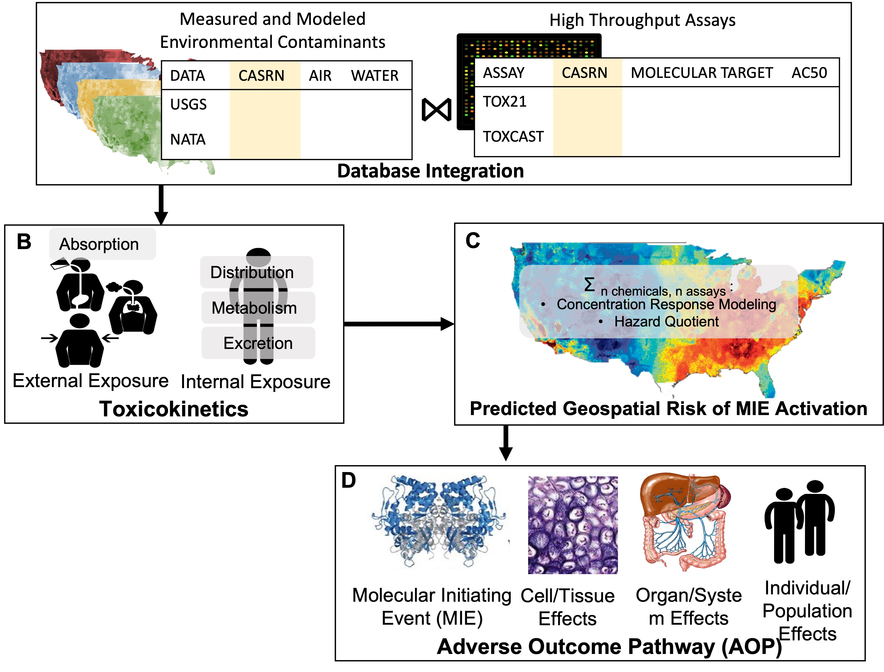
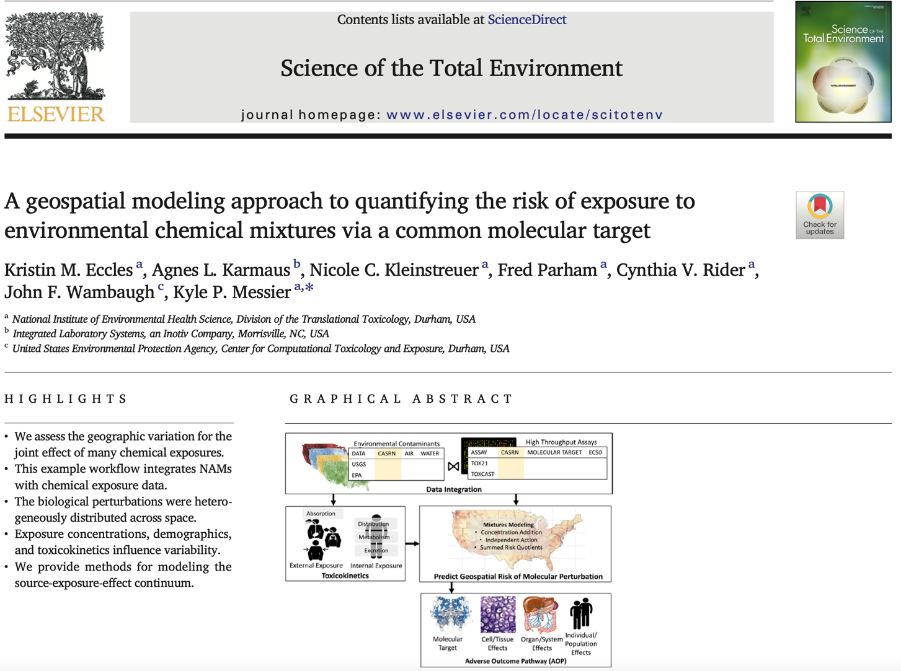
GeoTox Proof of Concept
12
2022 NIEHS POY

Slide 13
Key Steps in GeoTox Risk Mapping
13
External Exposure
Geospatial models
Gaussian process, land-use regression, chemical transport
Internal Exposure
Inhalation, Ingestion, Dermal absorption
In vitro equivalent dose
Physiologically Based Toxicokinetic Models
Dose Response Modeling
Toxicological Mixtures Predictions
Generalized Concentration Addition, Independent Action
In-vitro to In-vivo Extrapolation (IVIVE)
Adverse Outcome Pathways (AOP)
Integration into AOP(s)

Slide 14
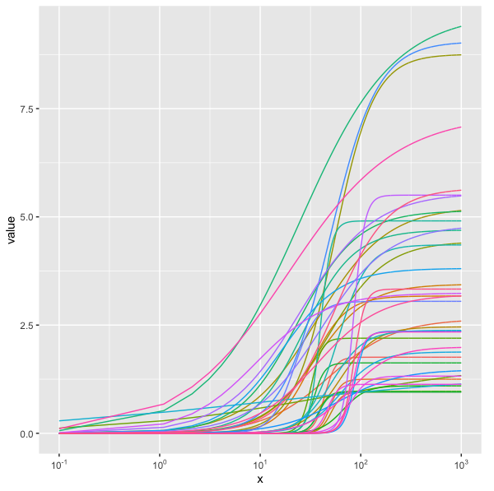
14
Chem-Transport Model
Toxicokinetics / ADME
Dose-Response
Notes:
A cascade – a sequence of necessary events. If something doesn’t happen the nothing downstream happens.

Slide 15
Mapped Risk of Molecular Perturbation
15
5th Percentile
Median
95th Percentile

Slide 16

GeoTox and Climate Risk: Near Term Possibilities
16
Increased precision in exposure assessment
Bringing precision environmental medicine to a larger scale
Spatial epidemiology exposures for cohort studies can be more sensitive if information is available (e.g. WGS, RNA-seq) to differentiate ADME within individuals
Geospatial approximation of molecular epidemiological methods
Mapping of AOP key events
Eccles et al. 2022

Slide 17
Long-Term Possibilities
17
Geospatial risk assessment for chemicals or stressors without epidemiology data
# Chemical D-R via NAM >> # Chemical D-R via epidemiology
Combining multiple AOPs and multiple routes of exposures
Comprehensive exposomic risk assessment

Slide 18
Some of the Current Limitations of GeoTox
18
Geospatial chemical exposure models have a “lamp-post” problem
Infinite Mixtures Problem
Uncertainty in each step of the framework
Pathways are complex!

Slide 19
Software and Computational Best-Practices
19
Towards Open, Available, Reproducible, Extensible, and Tested Geospatial Models

Slide 20
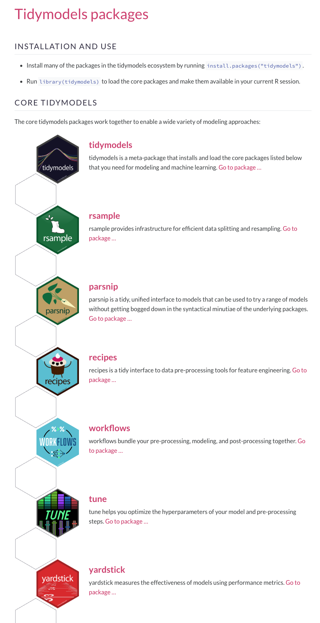
Tidymodels as motivation
20

Slide 21


21
Daniel Zilber
Ranadeep Daw
Eva Marques
Mariana Alifa
Mitchell Manware
(Data Analyst)
Insang Song
Kyle Messier

Slide 22
Software and Computational Best-Practices
22
Test Driven Development
Continuous Integration
Build Checks
Style / Linting
Workflows / Pipelines

Slide 23

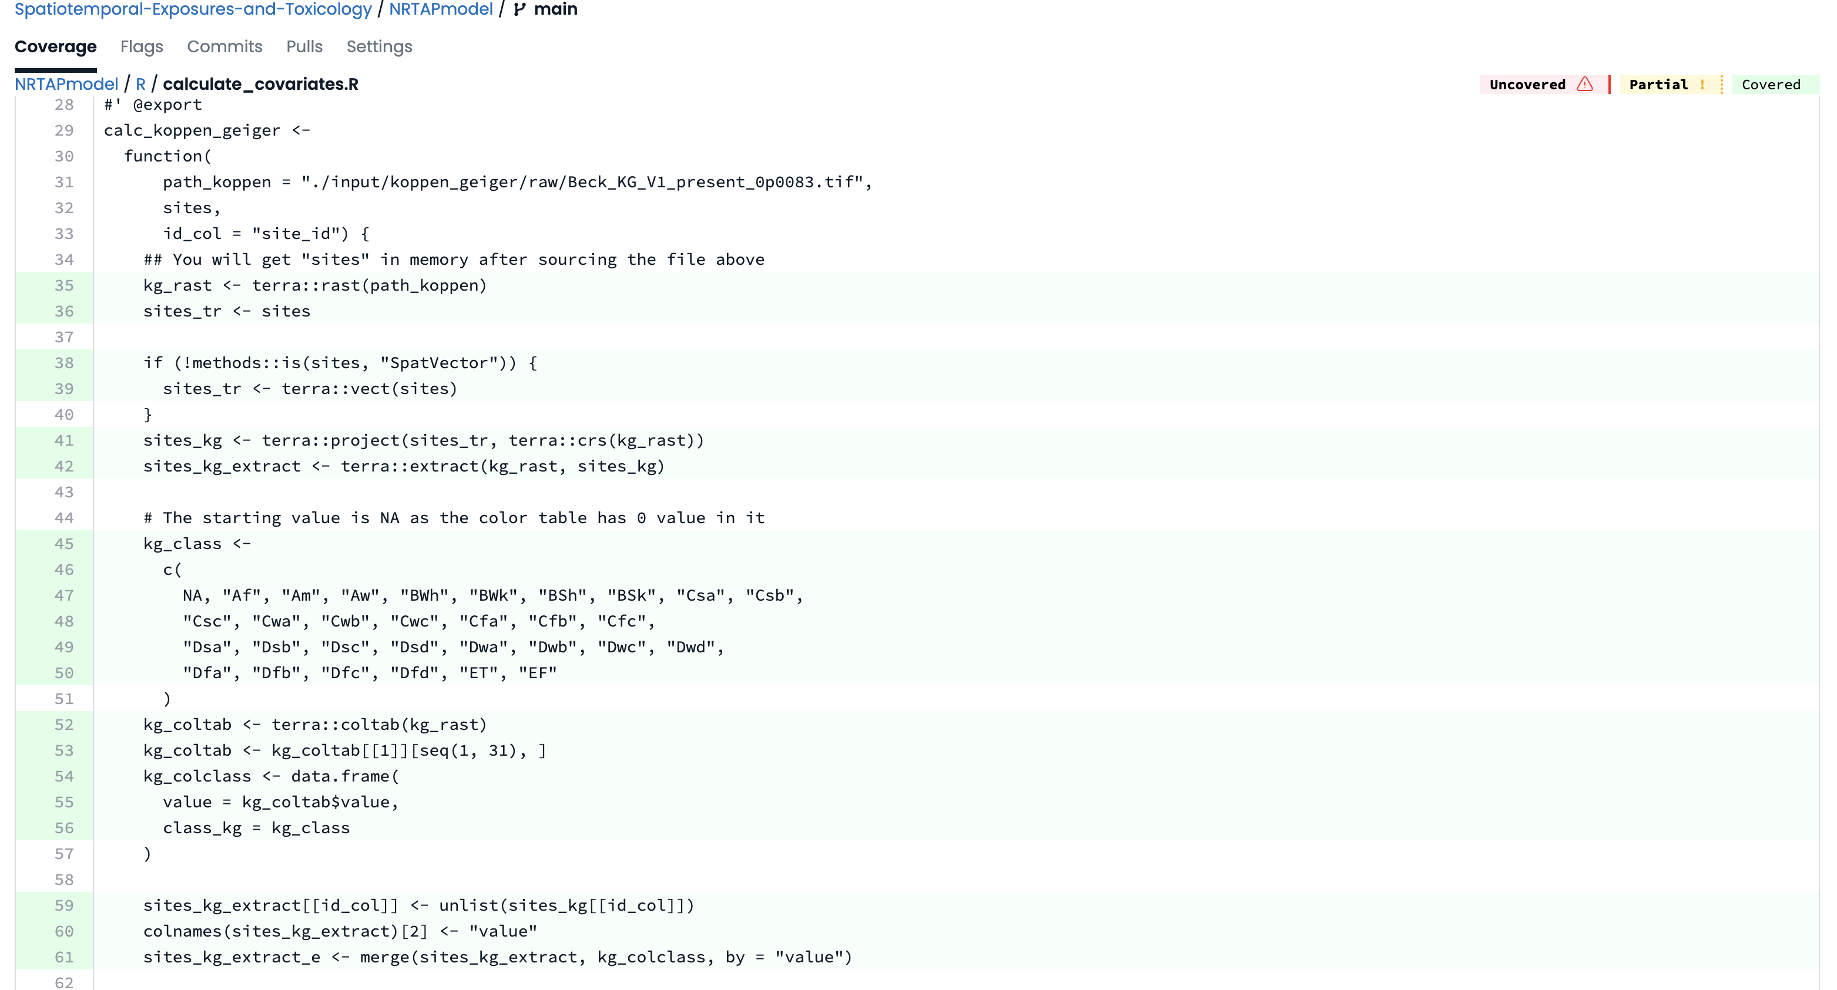

Test Driven Development: Tests and Coverage
23
Unit tests: Test a function or very specific piece of code e.g.
Does my function return an error when the input is wrong?
Does function return the expected value given a set of inputs?
expect_*
Integration tests: Tests the input from function X works with function Y
See testthat R package

Slide 24

Test Driven Development: The Philosophy
24
The Philosophy of Test-Driven Development (TDD)
Write a test
Run the test → Expect it to fail
Write the minimum code
Run the test → Till it passes
Refactor → Repeat → Complete
Forces you to think about code requirements
Forces explicit testing of code
Minimizes bugs
School of Athens, Raphael (1509–1511)

Slide 25
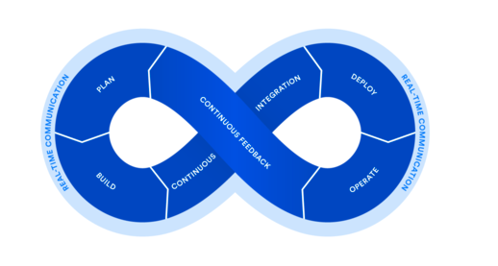
Continuous Integration
25
Frequent code commits
Detects errors sooner
Reduces complexity of debugging
Run code tests automatically
Makes working in groups easier

Slide 26
Build Check / R CMD check
26
Checks for major errors, minor errors, and recommendations
ERROR: Severe problems that you should fix regardless of whether or not you’re submitting to CRAN.
WARNING: Likely problems that you must fix if you’re planning to submit to CRAN (and a good idea to look into even if you’re not^{)1.}
NOTE: Mild problems or, in a few cases, just an observation.
Otherwise, you can learn about errors in the bad way!
¹https://r-pkgs.org/

Slide 27
Style and Linting
27
Consistent style → rEdability and_maintainability
Identifying syn.tax errors;
Semantic Errors

Slide 28


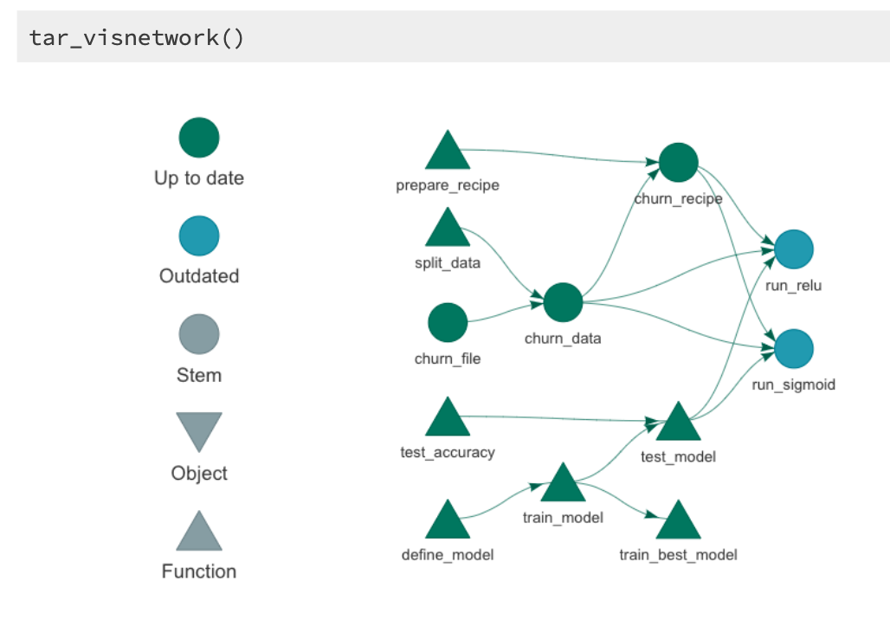
Pipelines and Workflows
28
Coordinate analysis with a DAG like structure
Skip steps that are not needed with updates
A pipeline is a computational workflow that does statistics, analytics, or data science
Facilitates code and package integration

Slide 29
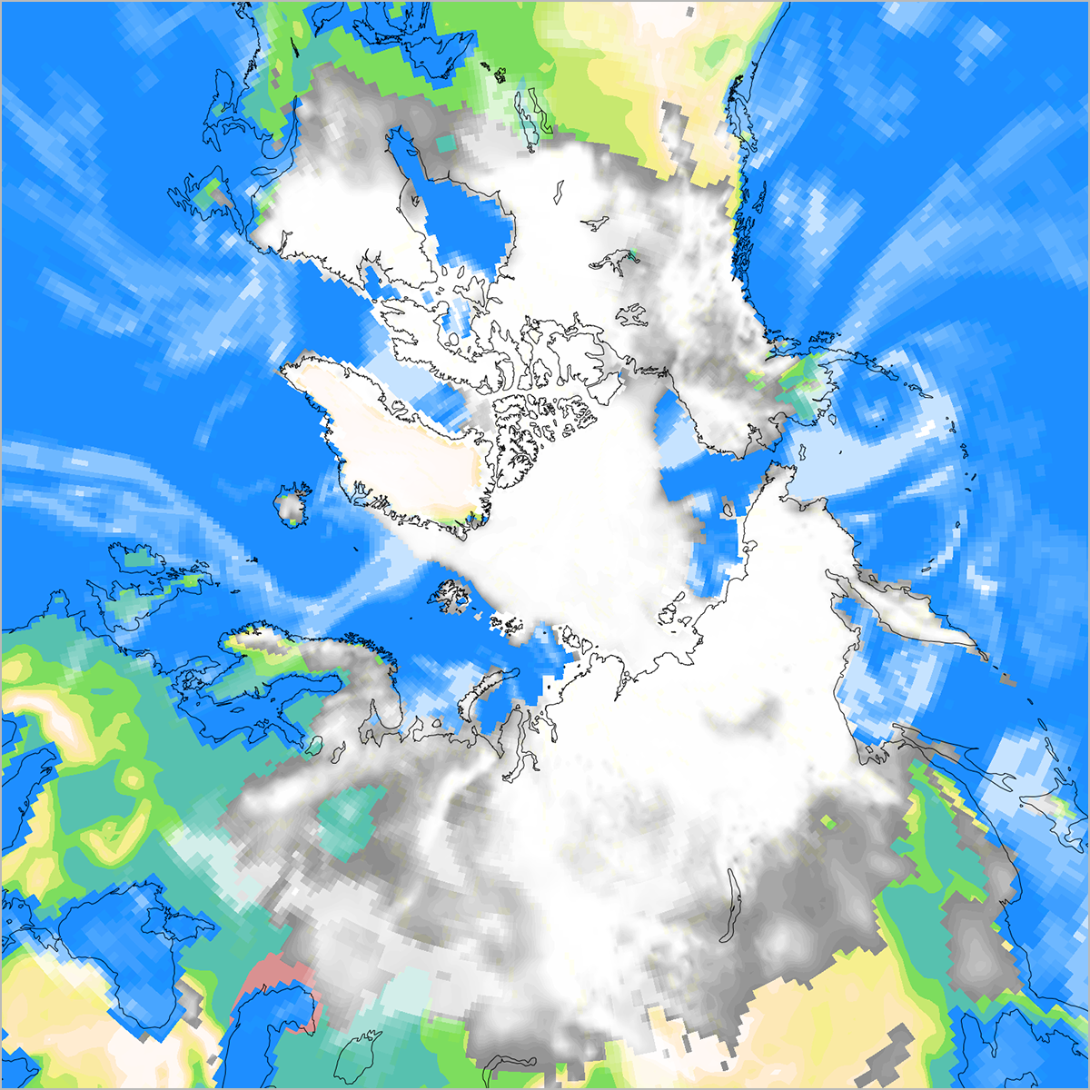
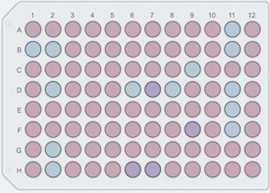
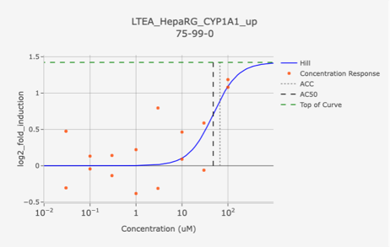
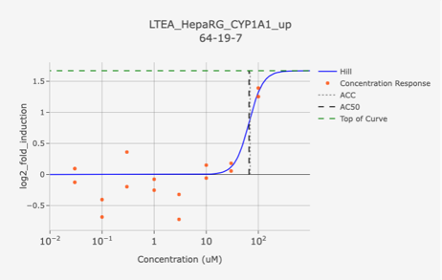
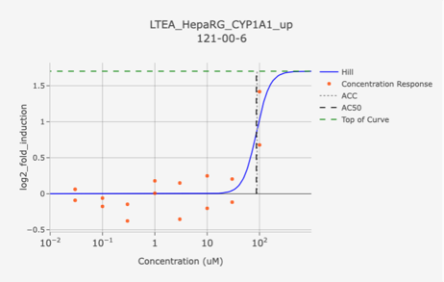
Best Practices are Needed for Complex Environmental Health Pipelines
29
Geospatial modeling and GeoTox offer a potential tractable approach for quantifying the exposome health impacts
Need best practices to build towards a very complex analysis and understanding
(1) In-Situ Monitoring Data (2) Atmospheric / Geophysical Data (3) Census Data (4) In-Vitro Screening Data (5) Concentration-Response Modeling (6) Probabilistic Models (7) …

Slide 30
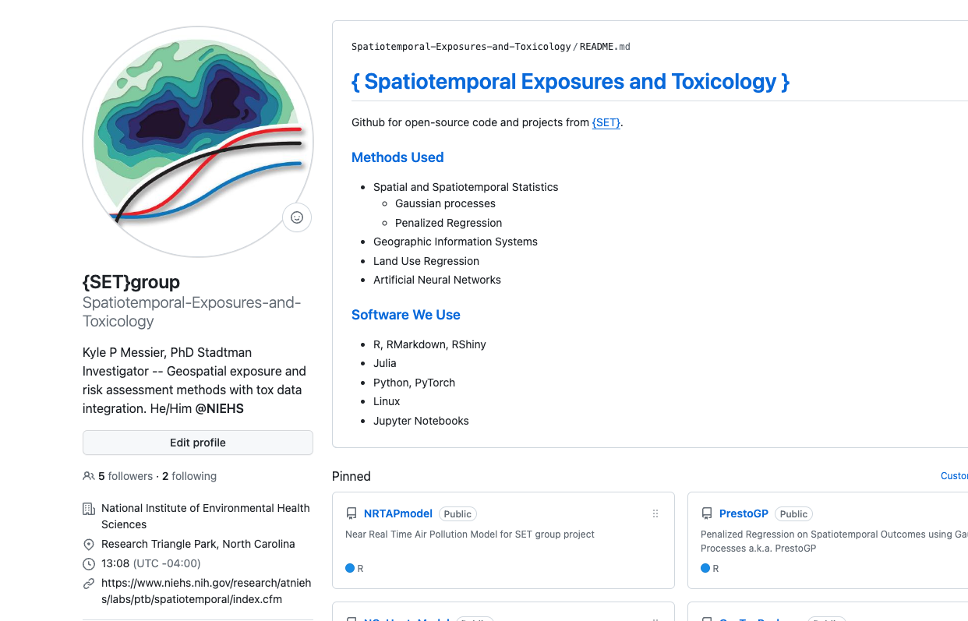
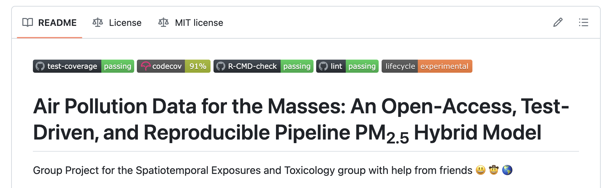
Documented, Tested, and Open
30

Slide 31
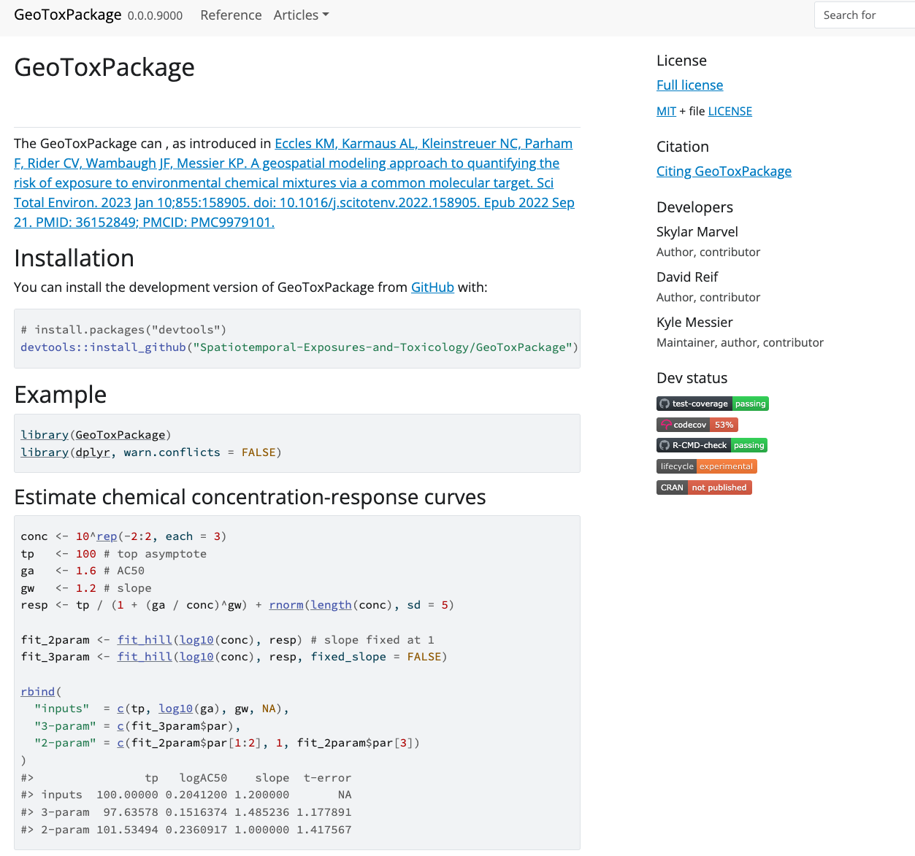
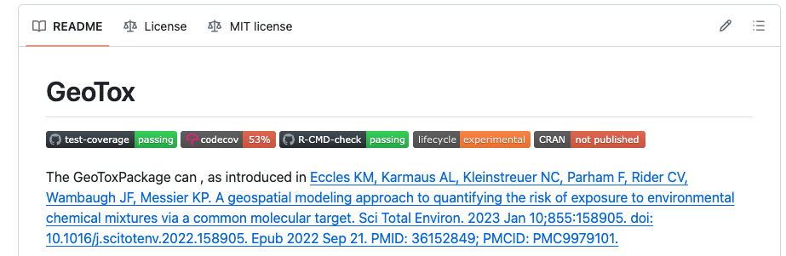
GeoTox R package
31
R package expected by Society of Toxicology meeting (March 2024)
Increase accessibility and extensibility of GeoTox
Improve computational speed

Slide 32

32
Environment-Health
Health Analysis
Spatial Stats
Geophysics
CS
Tentative or Early Plans to Form a Working Group on Software Best Practices in Environmental and Climate Health
Reach out if you are interested
CF conventions like process
NIEHS is moving to the NIH GitHub Enterprise

Slide 33



Acknowledgements
33
DTT
David Reif, PhD
Skylar Marvel, PhD
Biostatistics and Comp Biology
SET group
Daniel Zilber, PhD
Insang Song, PhD
Mariana Alifa, PhD
Ranadeep Daw, PhD
Eva Marques, PhD
Former members:
Kristin Eccles, PhD
Melissa Lowe, MS
Taylor Potter, BA
Alison Motsinger-Reif, PhD
Mitchell Manware, MS
Funding
Contact
kyle.messier@nih.gov
https://github.com/Spatiotemporal-Exposures-and-Toxicology

